Slide 1


AWS STEP FUNCTIONS Serverless Workflow Orchestration (Part 1)
By
Neerad Shakya
Developer, PACES Team
Notes:
11

Slide 2
Contents
Introduction
Amazon State Language(ASL) Overview
Basic State Machine with Lambda
Choice States
Question and Answers

Slide 3
1. INTRODUCTION

Slide 4
What is AWS Step Function?
Serverless Function Orchestrator
Helps to easily sequence execution of various AWS Services (Lambda, ECS Task, SNS, SQS, Batch)
Event driven workflow that maintain application state
Visual representation as step progresses
Automatic error handling, retry logic and state
Notes:
The Output of one step is the Input for the Next step

Slide 5
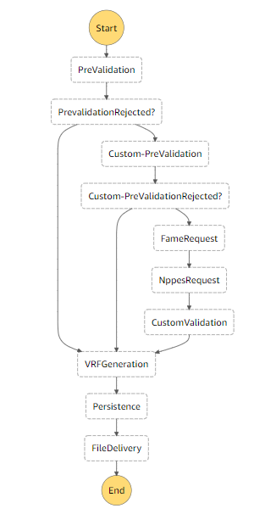
Example
Choices
Lambda/ECS Task

Slide 6
2. Amazon States Language(ASL)

Slide 7
ASL Overview
Amazon State Language(ASL) is a JSON-based, structured language used to define
your state machine,
a collection of states, that can do work (Task states),
determine which states to transition to next (Choice states),
stop an execution with an error (Fail states)
Pass data or State (Pass State)
And more as per the use case
Notes:
Paths

Slide 8
Top-Level Fields
{
"Comment": "A simple minimal example of the States language",
"StartAt": "Hello World",
"States": {
"Hello World": {
"Type": "Task",
"Resource": "arn:aws:lambda:us-east-1:123456789012:function:HelloWorld",
"End": true,
"Comment": "Executes HelloWorld Lambda"
}
},
"Version": "1.0"
}
Each State is
a Unit of Work
Optional
Mandatory
Mandatory based on Type

Slide 9
Types
Types define role of a state.
Different Types:
Task:
Executes work identified by it’s State Resource
Choice:
Lets you choose which state to go based on a certain variable
Fail:
Execution of State Machine is set to Fail.
Custom error message and cause can be set.
Pass:
No processing is done.
Just passes Input to Output.
Useful while debugging and constructing state machines

Slide 10
Types (Contd…)
Wait
delays the state machine from continuing for a specified time
Succeed
stops an execution successfully.
Useful target for Choice state branches that don't do anything but stop the execution.
Parallel
create parallel branches of execution in your state machine
Runs multiple steps with same Input
Map
can be used to run a set of steps for each element of an input array
Runs same steps with multiple inputs

Slide 11
Transitions
"Hello World": {
"Type": "Task",
"Resource": "arn:aws:lambda:us-east-1:123456789012:function:HelloWorld",
"Next": "Hello Universe",
"Comment": "Executes HelloWorld Lambda“
}
Next ➔ Links States together. Mandatory for all Non-Terminal States.
Terminal State ➔Any State with { "End": true }, or { "Type": "Succeed" }, or { "Type": "Fail" }
Optional
Mandatory
Mandatory based on Type

Slide 12
Data Flow
JSON Format
Initial input can be provided by Step Function caller.
Initial input is passed to Starting State
Default Input is empty JSON {}
Each Step can produce arbitrary Output JSON
Output JSON is passed to transitioning State as Input

Slide 13
Paths
Begins with $ or $$
$ identifies component within a JSON Text
$$ identifies component within a Context Object
{
"id": 1,
"data": ["a", "b"],
"obj": {
"valid": true
}
}
$.id➔1
$.data➔ ["a", "b"]
$.obj.valid➔true
"Payload": {
"TaskToken.$": "$$.Task.Token",
"State.$": "$"
}

Slide 14
3. Basic State Machine With Lambda
Lambda Function (.Net Core 3.1)
CDK 1.60 for deployment to AWS
AWS Toolkit 1.13 (VS code Extension)
AWS Step Function Console

Slide 15
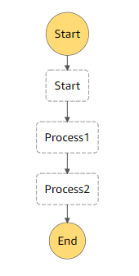
Work Flow
State Machine
{
"Comment": "Basic State Machine",
"StartAt": "Process1",
"States": {
"Process1": {
"Comment": "This performs process1",
"Type": "Task",
"Resource": "arn:aws:lambda:us-west-2:342600918501:function:StepFunctionDemoStack-Process1Function64F04A06-17G938HNXVVVD:$LATEST",
"Next": "Process2"
},
"Process2": {
"Comment": "This performs process2",
"Type": "Task",
"Resource": "arn:aws:lambda:us-west-2:342600918501:function:StepFunctionDemoStack-Process2Function273202F1-115XZSGTN9SJA: :$LATEST ",
"End": true
}
}
}
Process 1: Lambda Function 1
Process 2: Lambda Function 2
Notes:
arn:aws:lambda:us-west-2:342600918501:function:StepFunctionDemoStack-InvokeOddEvenStepFunction7A3-N2JNV0ERH6PV
arn:aws:lambda:us-west-2:342600918501:function:StepFunctionDemoStack-OddOrEvenFunction81FC086C-IBYRK04324X9
arn:aws:lambda:us-west-2:342600918501:function:StepFunctionDemoStack-Process1Function64F04A06-17G938HNXVVVD
arn:aws:lambda:us-west-2:342600918501:function:StepFunctionDemoStack-Process11Function70180133-E0ODIGT1W68L
arn:aws:lambda:us-west-2:342600918501:function:StepFunctionDemoStack-Process12FunctionD2B0C67B-M19KXQA7WANM
arn:aws:lambda:us-west-2:342600918501:function:StepFunctionDemoStack-Process2Function273202F1-115XZSGTN9SJA

Slide 16
4. Choice States

Slide 17
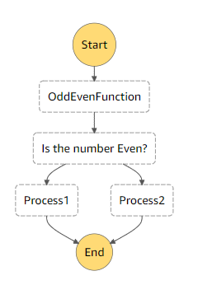
Single Condition (Odd/Even)
Work Flow
State Machine

Slide 18

Input Object
Generated Flow
{
“Value”:1
}
Choice Block
"Is the number Even?": {
"Type": "Choice",
"Choices": [
{
"Variable": "$.Result",
"StringEquals": "Even",
"Next": "Process1"
},
{
"Variable": "$.Result",
"StringEquals": "Odd",
"Next": "Process2"
}
]
}
{
“Value”:1
“Result”: Odd
}
Result=“Even” =>Process1
Result=“Odd” =>Process2
Independent Processes

Slide 19
Let’s add some more …

Slide 20
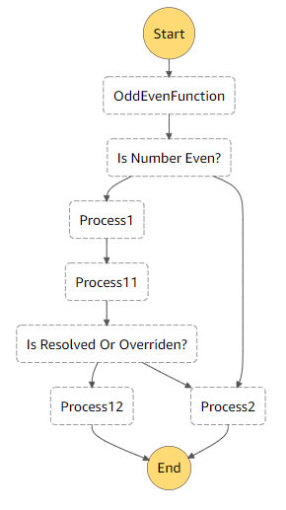
Work Flow
State Machine
Notes:
arn:aws:lambda:us-west-2:342600918501:function:StepFunctionDemoStack-Process11Function70180133-E0ODIGT1W68L
arn:aws:lambda:us-west-2:342600918501:function:StepFunctionDemoStack-Process12FunctionD2B0C67B-M19KXQA7WANM

Slide 21

Generated Flow
Input Object
{
“Value”:10
“Override”:false
}
Output Object of Process1
{
“Value”:10
“Result”: Even
}
Result=“Even” =>Process1
Result=“Even” =>Process2
{
“JobId”:”213432”,
“Resolved”:false,
“Data”:10,
“Override”:false
}
Choice Block
"Resolved or Overridden?": {
"Type": "Choice",
"Choices": [
{
"Or": [
{
"Variable": "$.Resolved",
"BooleanEquals": true
},
{
"Variable": "$.Override",
"BooleanEquals": true
}
],
"Next": "Process12"
}
]
,
"Default": "Process2"
}
if (Value==10 )
{
Resolved=true
}
Resolved=true OR Override=true => Process12
Some Independent Process

Slide 22

5. Question and Answer

Slide 23
References
https://aws.amazon.com/step-functions/
https://docs.aws.amazon.com/step-functions/latest/dg/concepts-amazon-states-language.html
https://states-language.net/

